Slide 1

CMR COLLEGE OF ENGINEERING & TECHNOLOGY
Kandlakoya, Medchal, Hyderabad - 501401
Department of Computer Science and Engineering
Image Classification using CNN with Cifar-10 Dataset
21H51A66E7 – D. Abhinav Kumar
21H51A66F6 – M. Indrasena Reddy
21H51A66G0 – P. Sai Shivanth
21H51A66G1 – P. Satya Sai Nikhil
Under esteemed guidance of
Dr. T. Bhaskar
Associate Professor CSM Department

Slide 2
Contents
Abstract
Introduction
- Motivation of study
- Objectives
- Scope and limitations of study
Literature survey
- Existing System / Methods
- Procedure of each method
- Merits and demerits of each method
- Implementation of existing method
Data Collection & Performance metrics
- Size of data set
- Categorisation(If applicable)
- Study of Performance Metrics
Proposed work
- Proposed System architecture
- Method description
- Implementation
Results/Output
Performance Analysis
- Proposed method performance on data set
- Existing methods performance on data set
Conclusion & Future Work

Slide 3
Abstract
Image classification is a fundamental task in computer vision that involves assigning a label or category to an image.
Convolutional Neural Networks (CNNs) have become the state-of-the-art method for image classification due to their ability to automatically learn features from raw pixel values.
In this project, we aim to build a CNN model that can accurately classify images in the CIFAR-10 dataset.

Slide 4
Introduction
Motivation of Study: Image classification's fundamental role in computer vision. CNNs' effectiveness in automatic feature learning.
Objectives: Build a CNN model for CIFAR-10 classification and achieve accurate image labeling in 10 classes.
Scope: Application of CNNs in image classification.
Limitations: 32x32 pixel size and 10 predefined classes.

Slide 5
Literature Survey
Learning Multiple Layers of Features from Tiny Images (Alex Krizhevsky):
Procedure: Deep learning on small images.
Merits/Demerits: Robust features, computationally intensive.
Very Deep Convolutional Networks for Large-Scale Image Recognition (Karen Simonyan, Andrew Zisserman):
Procedure: Deep convolutional networks.
Merits/Demerits: High accuracy, complex architecture.

Slide 6
Data Collection and Performance Metrics
Data Collection:
CIFAR – 10 an established computer-vision dataset
- 60,000 Images
- 10 classes.
Performance Metrics:
- Accuracy
- loss curves
- confusion matrix.

Slide 7
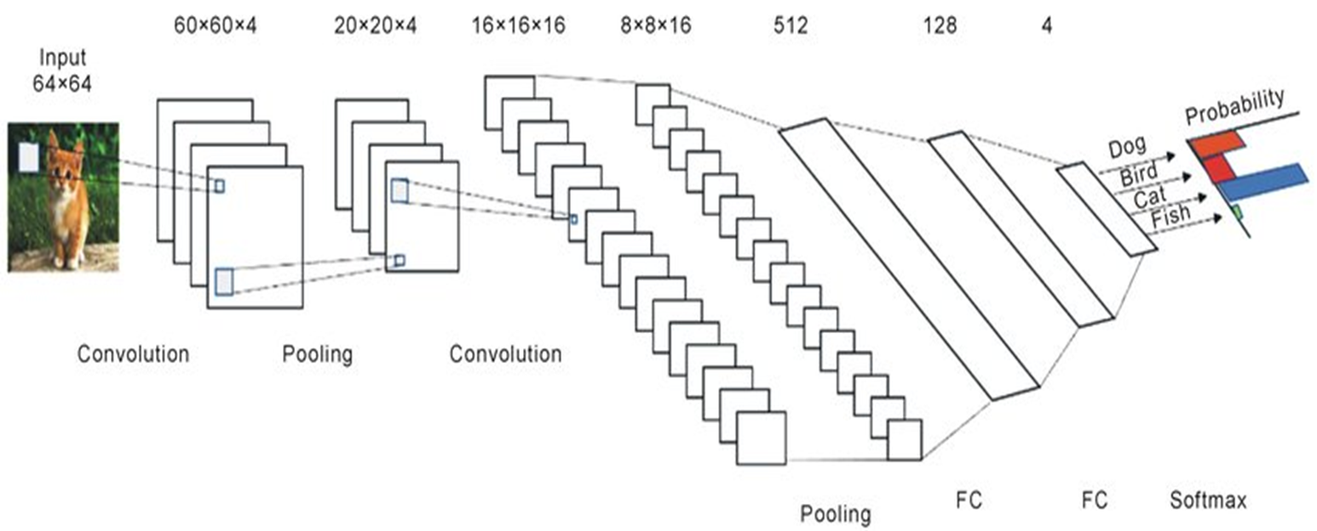
Proposed Work
Architecture: CNN architecture with convolutional, pooling, and fully connected layers.

Slide 8
Proposed Work
Method Description:
In consideration with all the existing systems we came up a solution of using
the CNN
Implementation:
Imported the dataset by using Keras and trained it to the CNN

Slide 9
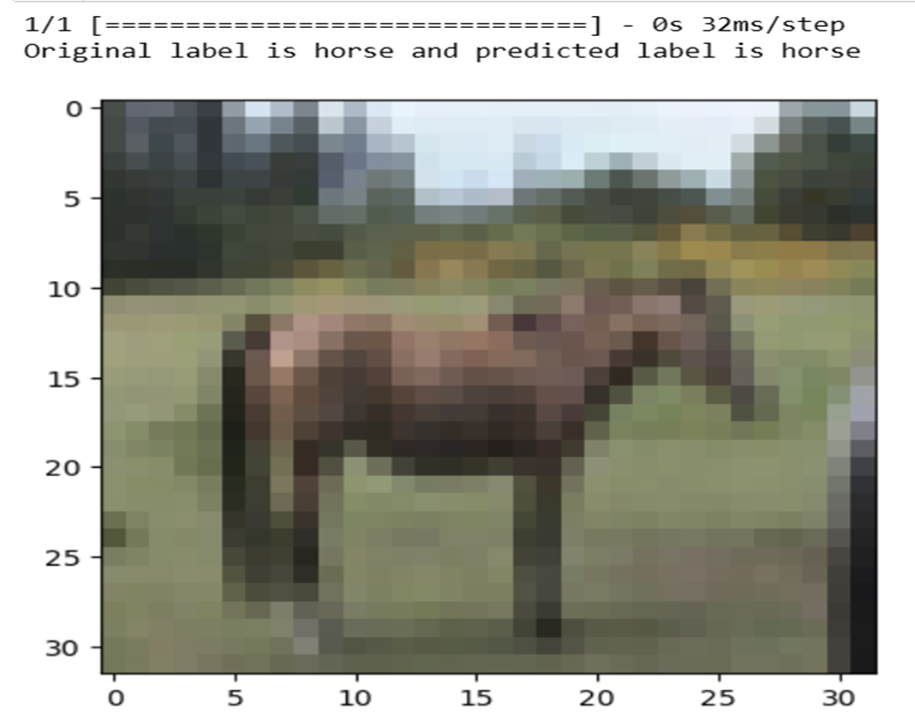
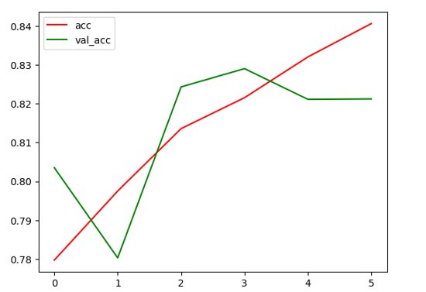
Results
The result in case of our CNN Model is 82.12 %

Slide 10
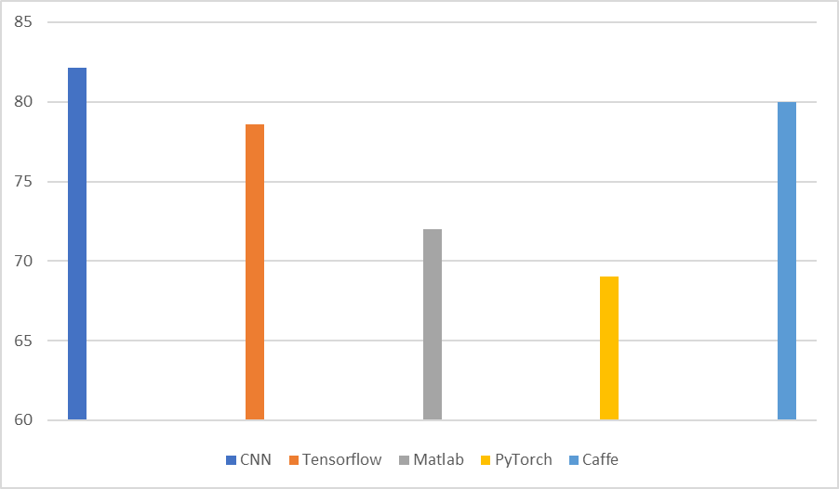
Performance Analysis
Proposed Method Performance: Evaluate accuracy, loss on test set.
Existing Method Performance: Compare with
- TensorFlow
- PyTorch
- MatLab
- Caffe.

Slide 11
Conclusion and Future Work
Effective Image Classification: The CNN model excelled in accurately categorizing CIFAR-10 images, demonstrating strong pattern recognition and achieving notable performance metrics.
Optimization Opportunities: Future work could focus on fine-tuning hyperparameters and exploring advanced CNN architectures, enhancing the model's adaptability and overall performance.
Real-World Applications: Extending the project to real-world scenarios and diverse applications would provide valuable insights, aligning the model with practical utility and potential industry implementations.

Slide 12
Thank You

